Slide 1
Working with Interfaces
Lecture 7
IEnumerable, IComparable, Icomparer
Regular expressions

Slide 2
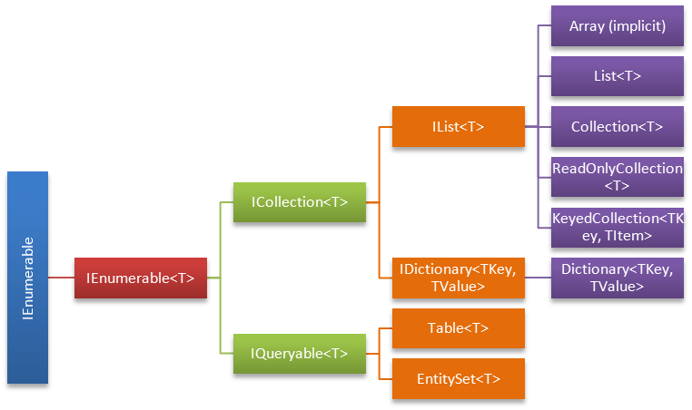
IEnumerable
Exposes an enumerator, which supports a simple iteration over a non-generic collection.

Slide 3
Only One Method of IEnumerable interface
GetEnumerator()
Enumerators can be used to read the data in the collection, but they cannot be used to modify the underlying collection.
IEnumerator – interface that has
PROPERTY – Current
METHODS
MoveNext
Reset

Slide 4
SAMPLE
public class Person
{
public Person(string fName, string lName)
{
this.firstName = fName;
this.lastName = lName;
}
public string firstName;
public string lastName;
}

Slide 5
public class People : IEnumerable
{
private Person[] _people;
public People(Person[] pArray)
{
_people = new Person[pArray.Length];
for (int i = 0; i < pArray.Length; i++)
{
_people[i] = pArray[i];
}
}
// Implementation for the GetEnumerator method.
IEnumerator IEnumerable.GetEnumerator()
{
return (IEnumerator) GetEnumerator();
}
public PeopleEnum GetEnumerator()
{
return new PeopleEnum(_people);
}
}

Slide 6
public class PeopleEnum : IEnumerator
{
public Person[] _people;
// Enumerators are positioned before the first element
// until the first MoveNext() call.
int position = -1;
public PeopleEnum(Person[] list)
{
_people = list;
}
public bool MoveNext()
{
position++;
return (position < _people.Length);
}
public void Reset()
{
position = -1;
}
object IEnumerator.Current
{
get
{
return Current;
}
}
public Person Current
{
get
{
try
{
return _people[position];
}
catch (IndexOutOfRangeException)
{
throw new InvalidOperationException();
}
}
}
}

Slide 7
class App
{
static void Main()
{
Person[] peopleArray = new Person[3]
{
new Person("John", "Smith"),
new Person("Jim", "Johnson"),
new Person("Sue", "Rabon"),
};
People peopleList = new People(peopleArray);
foreach (Person p in peopleList)
Console.WriteLine(p.firstName + " " + p.lastName);
}
}

Slide 8
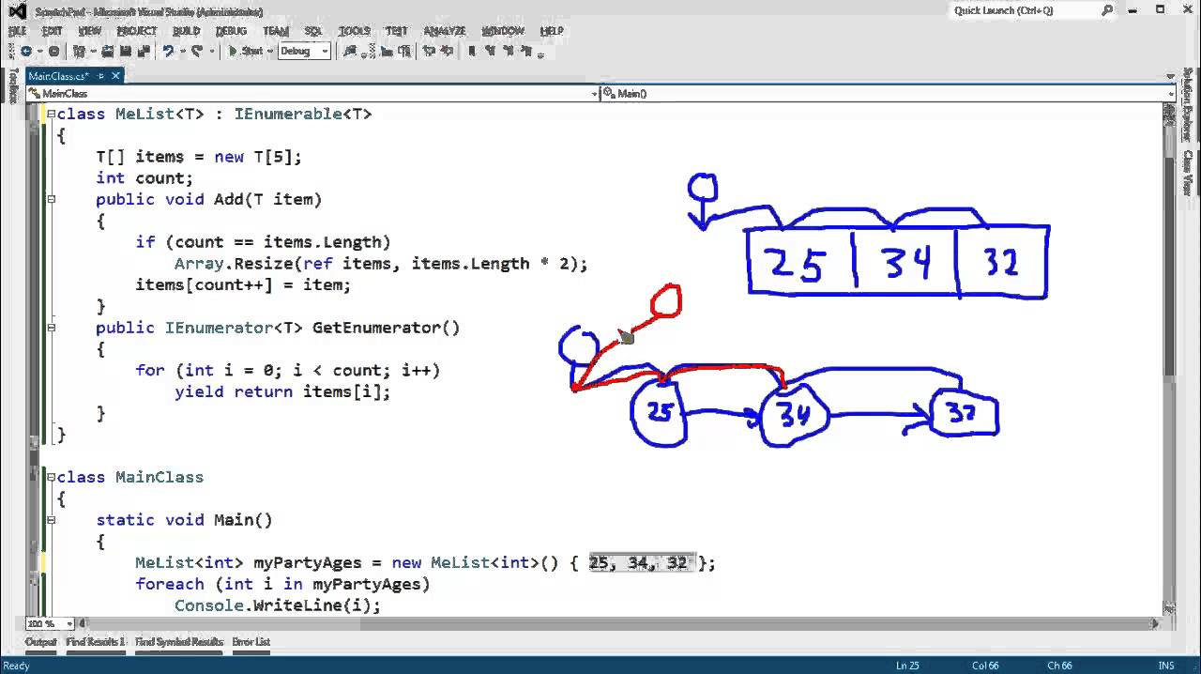
USING yield KEYWORD

Slide 9
YIELD
Yield is not a feature of the .Net runtime. It is just a C# language feature. During compilation Compiler converts yield method and its class to instances of IEnumerable and IEnumerator implemented classes.

Slide 10
IComparable
Defines a generalized type-specific comparison method that a value type or class implements to order or sort its instances.

Slide 11
Exposes Method that returns Integer value (-;0;+)
 | Name | Description
 | CompareTo(Object) | Compares the current instance with another object of the same type and returns an integer that indicates whether the current instance precedes, follows, or occurs in the same position in the sort order as the other object.

Slide 12
EXAMPLE
public class Temperature : IComparable
{
// The temperature value
protected double temperatureF;
public int CompareTo(object obj) {
if (obj == null) return 1;
Temperature otherTemperature = obj as Temperature;
if (otherTemperature != null)
return this.temperatureF.CompareTo(otherTemperature.temperatureF);
else
throw new ArgumentException("Object is not a Temperature");
}
}

Slide 13
public static void Main()
{
ArrayList temperatures = new ArrayList();
// Initialize random number generator.
Random rnd = new Random();
// Generate 10 temperatures between 0 and 100 randomly.
for (int ctr = 1; ctr <= 10; ctr++)
{
int degrees = rnd.Next(0, 100);
Temperature temp = new Temperature();
temp.Fahrenheit = degrees;
temperatures.Add(temp);
}
// Sort ArrayList.
temperatures.Sort();
foreach (Temperature temp in temperatures)
Console.WriteLine(temp.Fahrenheit);
}

Slide 14
IComparer interface
Exposes a method that compares two objects.

Slide 15
EXAMPLE
public class myReverserClass : IComparer {
// Calls CaseInsensitiveComparer.Compare with the parameters reversed.
int IComparer.Compare( Object x, Object y ) {
return( (new CaseInsensitiveComparer()).Compare( y, x ) );
}
}

Slide 16
ArrayList myAL = new ArrayList();
myAL.Add( "The" );
myAL.Add( "quick" );
myAL.Add( "brown" );
myAL.Add( "fox" );
myAL.Add( "jumps" );
myAL.Add( "over" );
myAL.Add( "the" );
myAL.Add( "lazy" );
myAL.Add( "dog" );
myAL.Sort(); // Will sort ascending
IComparer myComparer = new myReverserClass();
myAL.Sort( myComparer ); //Now will sort descending

Slide 17
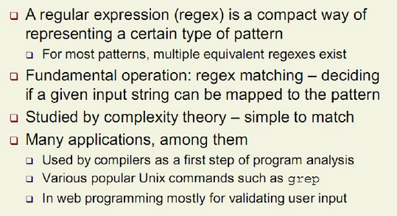
Regular Expressions

Slide 18

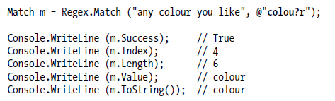
BASICS

Slide 19
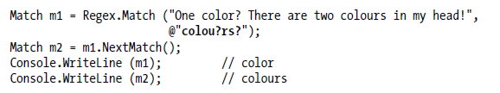

ITERATE MATCHES
COMPILED

Slide 20
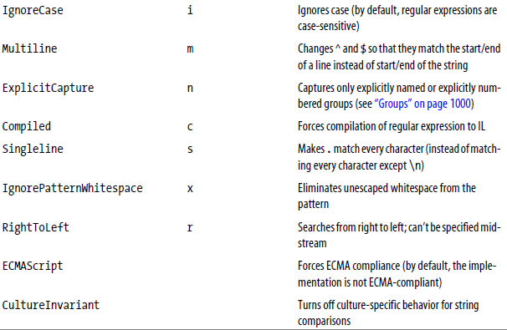
REGEX OPTIONS

Slide 21

CHARACTER ESCAPES

Slide 22
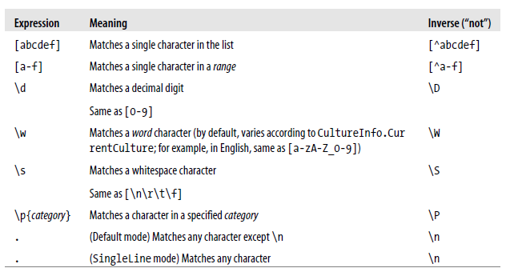
CHARACTER SETS

Slide 23

EXAMPLES

Slide 24
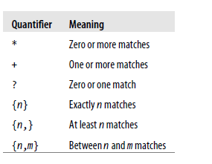
QUANTIFIERS

Slide 25

EXAMPLES

Slide 26



GREEDY VS LAZY QUANTIFIERS

Slide 27
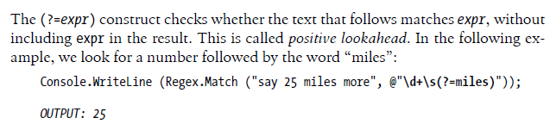
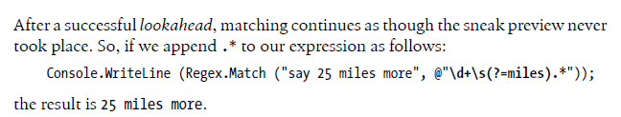

LOOK AHEAD AND LOOK BEHIND

Slide 28
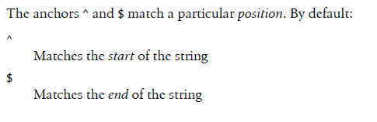

ANCHORS

Slide 29
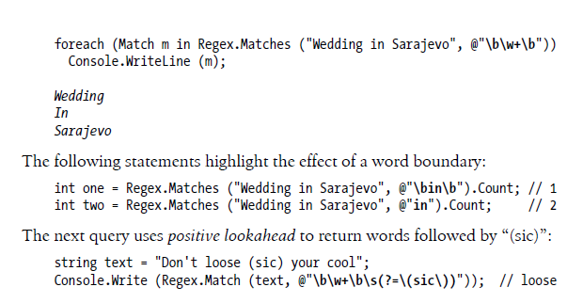
BOUNDARIES

Slide 30



GROUPS

Slide 31
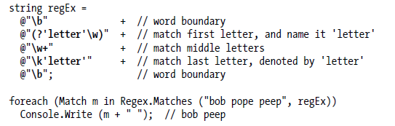
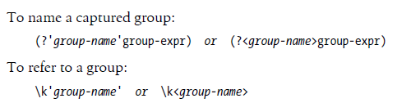
NAMED GROUPS

Slide 32
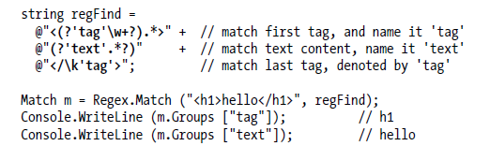
EXAMPLE

Slide 33
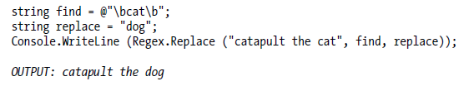

REPLACE

Slide 34
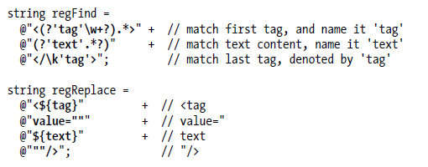
EXAMPLE

Slide 35

SPLIT

Slide 36
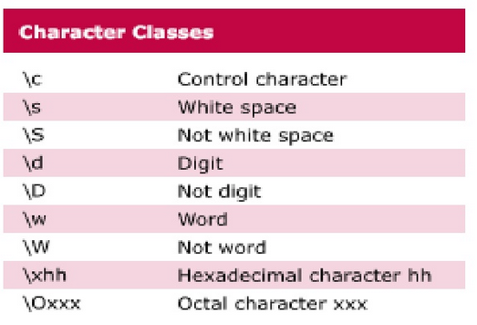
Character classes

Slide 37
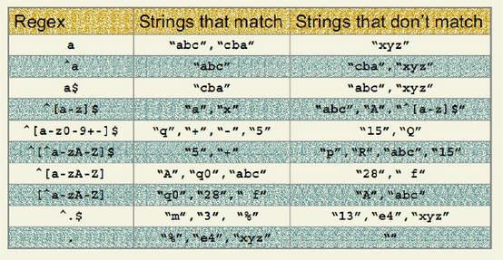
Examples

Slide 38
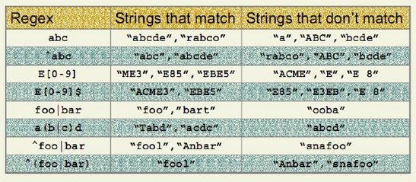
Examples

Slide 39
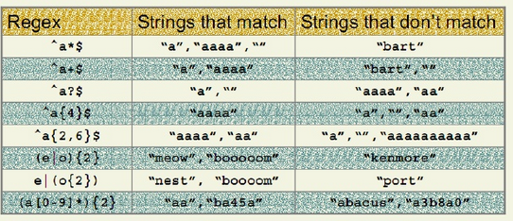
Examples

Slide 40
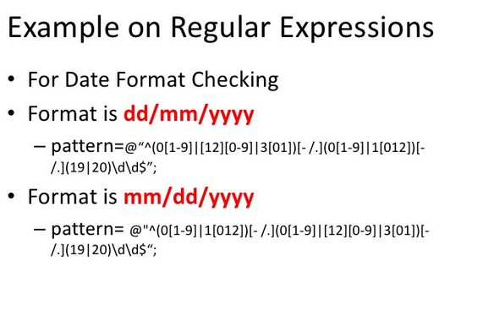
Examples

Slide 41
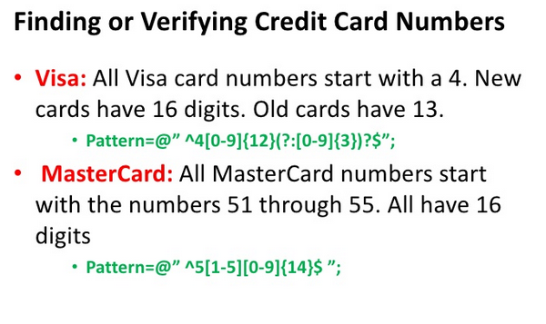
Examples

Slide 42
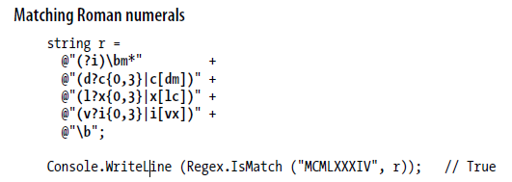
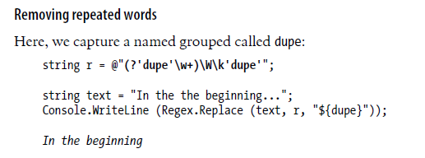
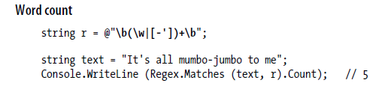
USEFULL EXAMPLES

Slide 43
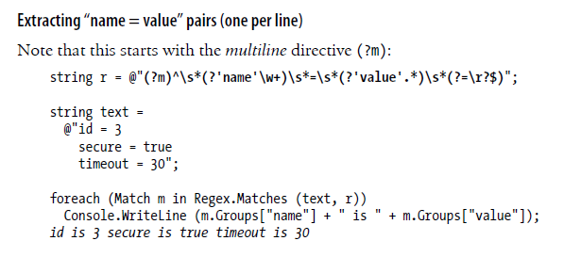
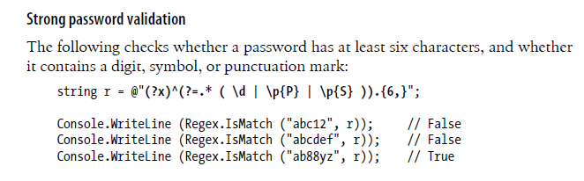
USEFULL EXAMPLES

Slide 44
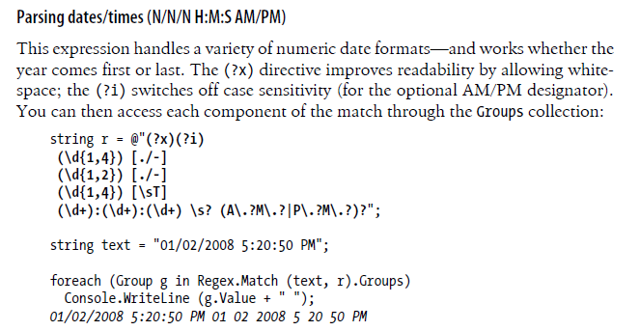

Slide 45
RESOURCES TO CHECK REGEX
http://derekslager.com/blog/posts/2007/09/a-better-dotnet-regular-expression-tester.ashx
https://www.myregextester.com/

